Slide 1
Test plan discussion
Dishwasher

Slide 2
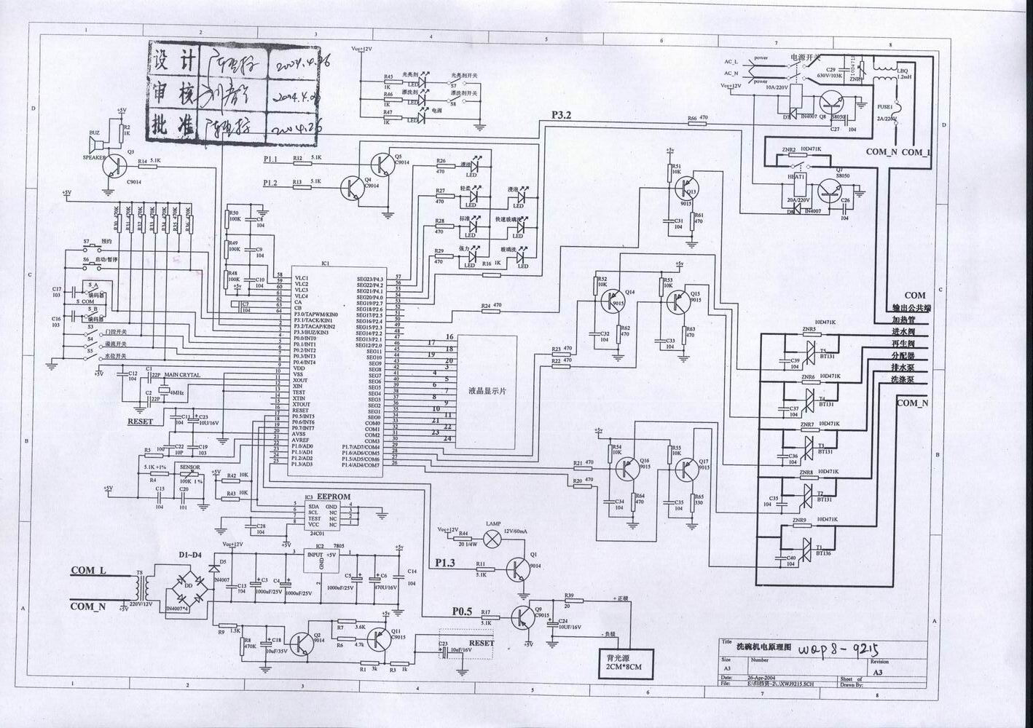
Construction

Slide 3
Procedure and function:

Slide 4
Procedure and function:

Slide 5
Disturbance Source
IC (programmer, etc)
Crystal Oscillator
TRIAC
Relay

Slide 6
Sensitive components for immunity test
IC (programmer, EEPROM, etc)
TRIAC

Slide 7
Applicable standards
EN 55014-1:2000+A1+A2
EN 55014-2:1997+A1
EN 61000-3-2:2000
EN 61000-3-3:1995+A1

Slide 8
Test items/operation modes
DV
DP
Click
Flicker
Harmonics
EMS for Household ( On )

Slide 9


